Slide 1
III. Recurrent Neural Networks
Notes:
Part 3A: Hopfield Network

Slide 2
A.
The Hopfield Network
Notes:
Part 3A: Hopfield Network

Slide 3
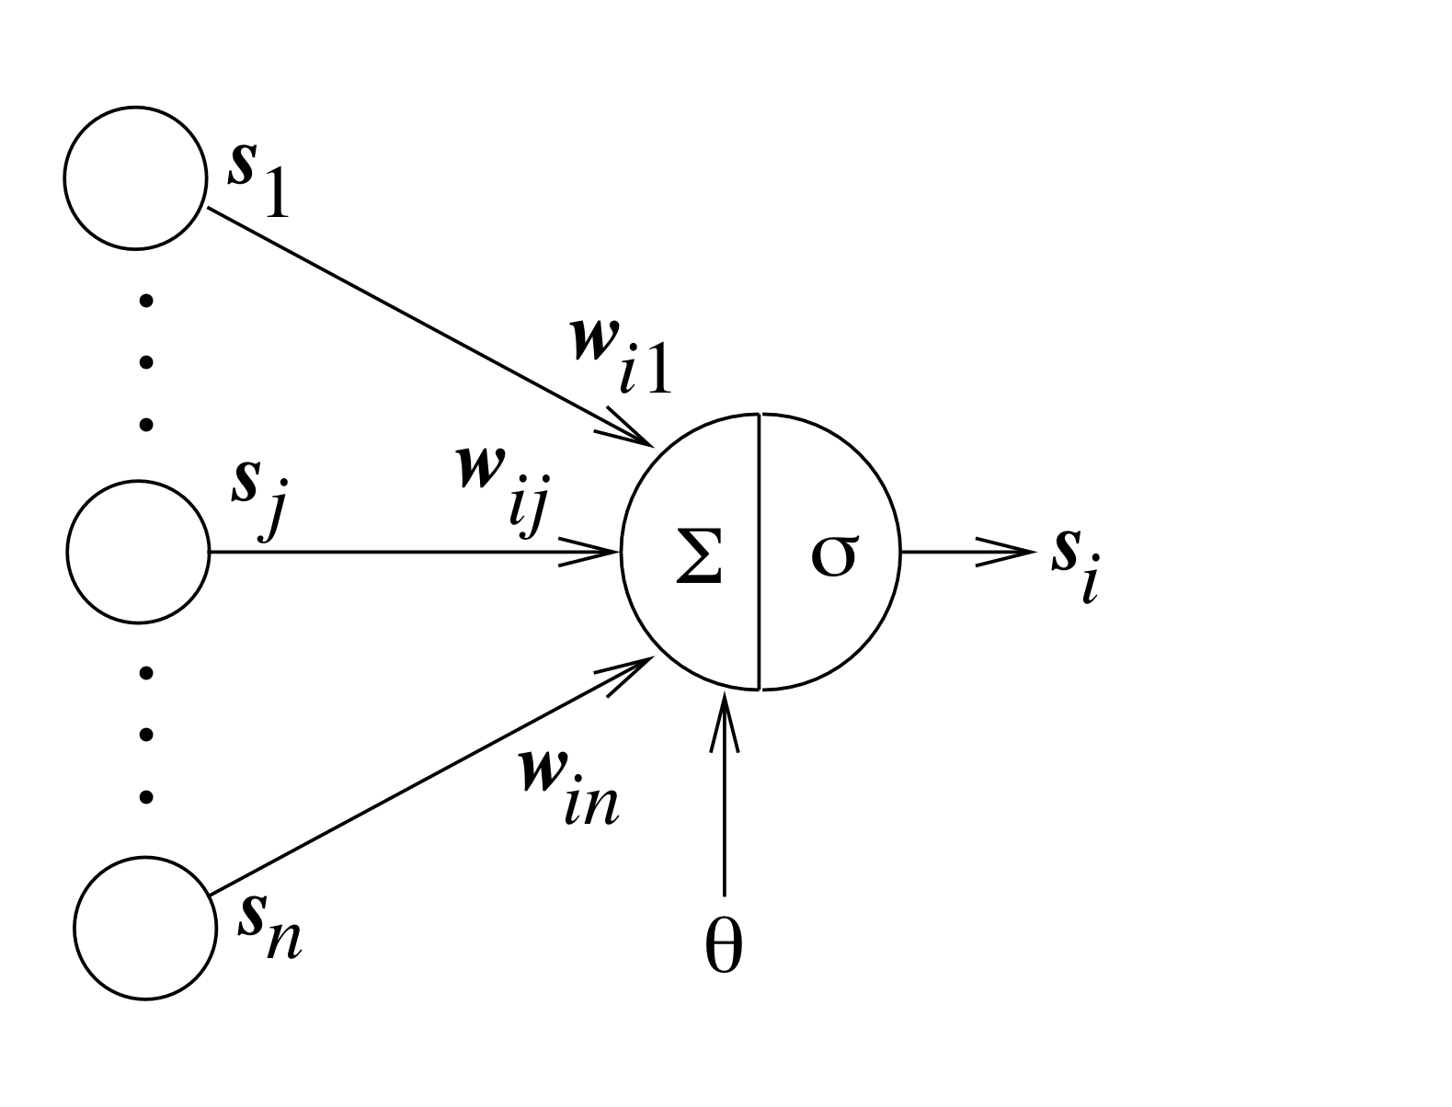
Typical Artificial Neuron
connection
weights
inputs
output
threshold
Notes:
Part 3A: Hopfield Network

Slide 4
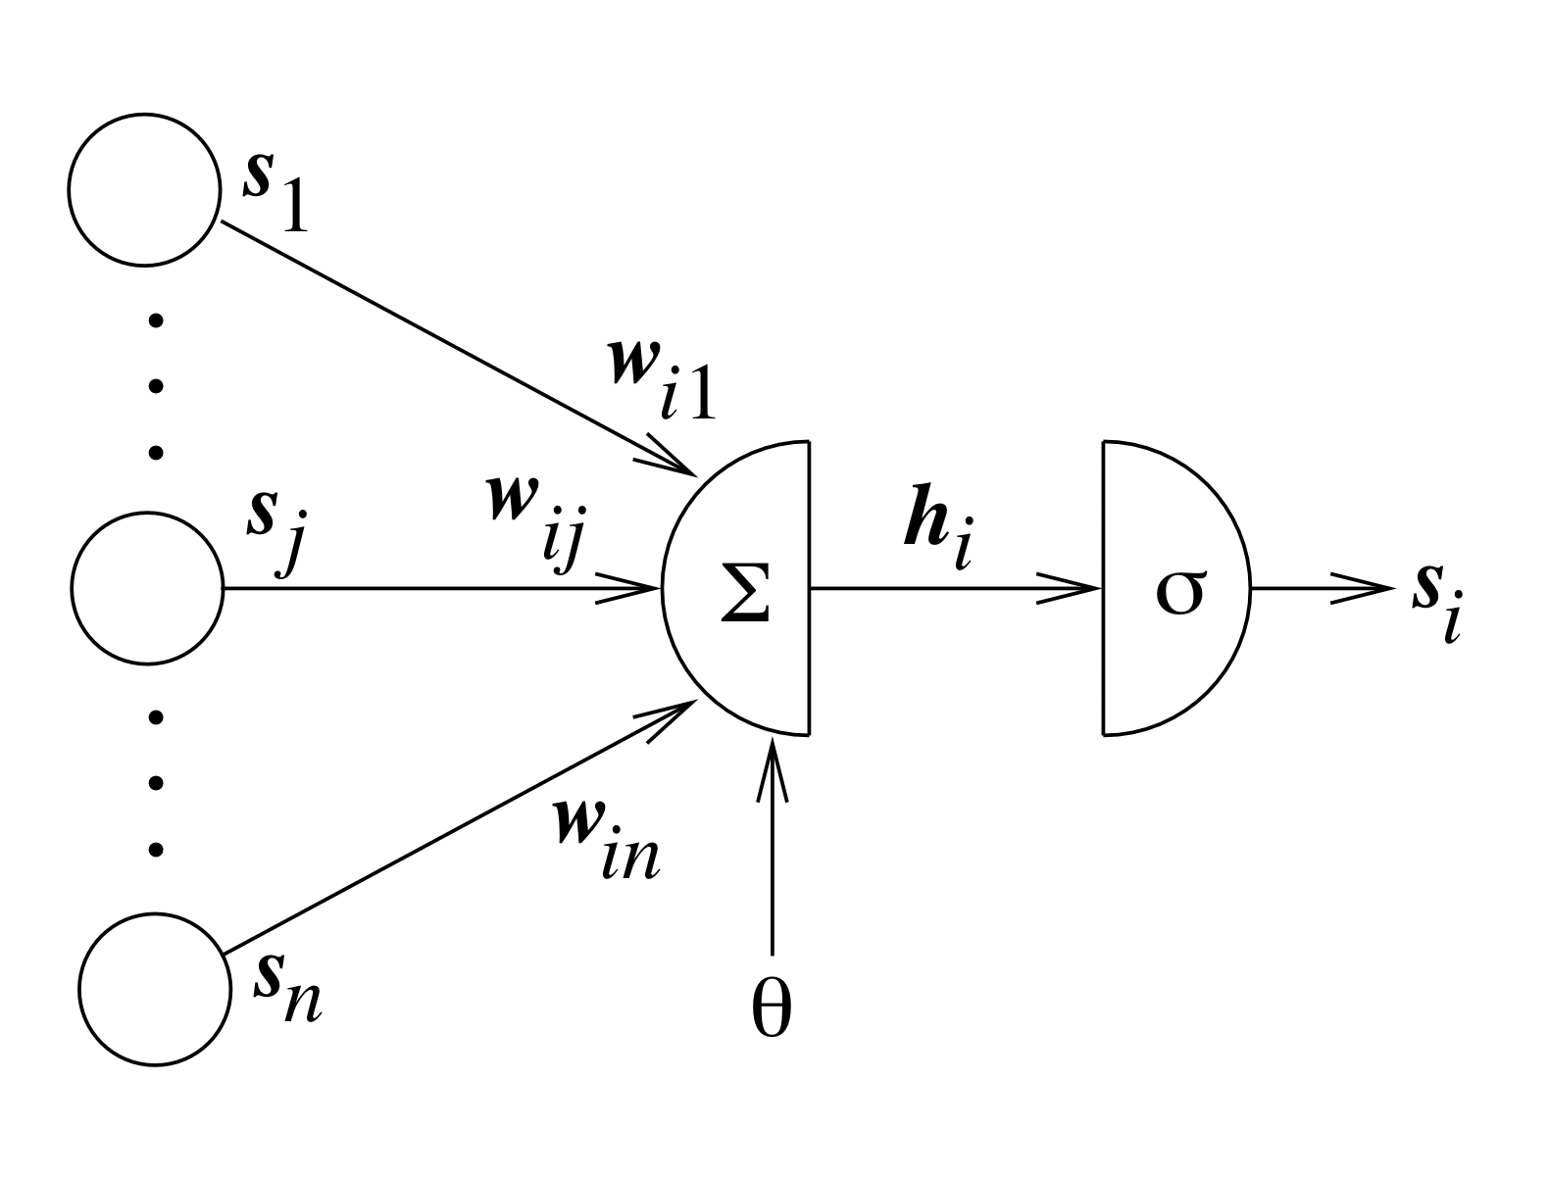
Typical Artificial Neuron
linear
combination
activation
function
net input
(local field)
Notes:
Part 3A: Hopfield Network

Slide 5
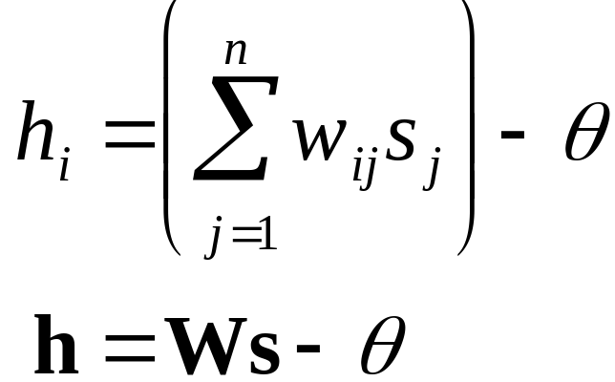
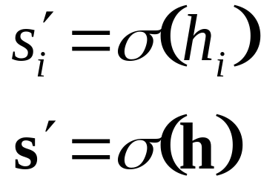
Equations
Net input:
New neural state:
Notes:
Part 3A: Hopfield Network

Slide 6
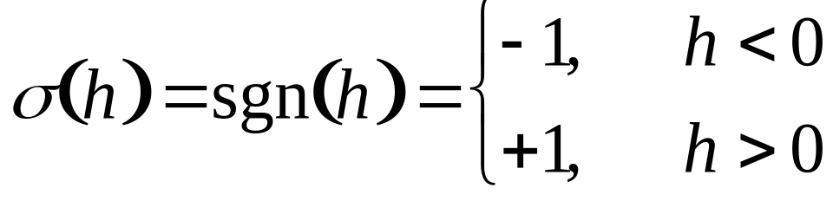
Hopfield Network
Symmetric weights: w_{ij} = w_{ji}
No self-action: w_{ii} = 0
Zero threshold: θ = 0
Bipolar states: s_{i} ∈ {–1, +1}
Discontinuous bipolar activation function:
Notes:
Part 3A: Hopfield Network
Technically, sgn(0) = 0

Slide 7
What to do about h = 0?
There are several options:
  σ(0) = +1
  σ(0) = –1
  σ(0) = –1 or +1 with equal probability
  h_{i} = 0 ⇒ no state change (s_{i}′ = s_{i})
Not much difference, but be consistent
Last option is slightly preferable, since symmetric
Notes:
Part 3A: Hopfield Network
Last option leads to symmetric flow diagram
(Haykin 291, fig. 8.1)

Slide 8
Positive Coupling
Positive sense (sign)
Large strength
Notes:
Part 3A: Hopfield Network

Slide 9
Negative Coupling
Negative sense (sign)
Large strength
Notes:
Part 3A: Hopfield Network

Slide 10
Weak Coupling
Either sense (sign)
Little strength
Notes:
Part 3A: Hopfield Network

Slide 11
State = –1 & Local Field < 0
h < 0
Notes:
Part 3A: Hopfield Network
These are microdecisions, which will lead to macrobehavior (of whole net)

Slide 12
State = –1 & Local Field > 0
h > 0
Notes:
Part 3A: Hopfield Network

Slide 13
State Reverses
h > 0
Notes:
Part 3A: Hopfield Network

Slide 14
State = +1 & Local Field > 0
h > 0
Notes:
Part 3A: Hopfield Network

Slide 15
State = +1 & Local Field < 0
h < 0
Notes:
Part 3A: Hopfield Network

Slide 16
State Reverses
h < 0
Notes:
Part 3A: Hopfield Network

Slide 17
NetLogo Demonstration of Hopfield State Updating
Run Hopfield-update.nlogo
Notes:
Part 3A: Hopfield Network
Note this is netlogo 4.0.

Slide 18
Hopfield Net as Soft Constraint Satisfaction System
States of neurons as yes/no decisions
Weights represent soft constraints between decisions
  hard constraints must be respected
  soft constraints have degrees of importance
Decisions change to better respect constraints
Is there an optimal set of decisions that best respects all constraints?
Notes:
Part 3A: Hopfield Network
hard constraints must be respected
soft constraints do not have to be; have degrees of importance
soft constraints are more relevant in natural computation
where must deal with conflicting requirements, noise etc.
Again: microdecisions & macrobehavior

Slide 19
Demonstration of Hopfield Net Dynamics I
Run Hopfield-dynamics.nlogo
Notes:
Part 3A: Hopfield Network
Uses Netlogo 4.0.
After state initialization, drop speed to about 1/2.

Slide 20
Convergence
Does such a system converge to a stable state?
Under what conditions does it converge?
There is a sense in which each step relaxes the “tension” in the system
But could a relaxation of one neuron lead to greater tension in other places?
Notes:
Part 3A: Hopfield Network

Slide 21
Quantifying “Tension”
If w_{ij} > 0, then s_{i} and s_{j} want to have the same sign (s_{i} s_{j} = +1)
If w_{ij} < 0, then s_{i} and s_{j} want to have opposite signs (s_{i} s_{j} = –1)
If w_{ij} = 0, their signs are independent
Strength of interaction varies with |w_{ij}|
Define disharmony (“tension”) D_{ij} between neurons i and j:
  D_{ij} = – s_{i} w_{ij} s_{j}
  D_{ij} < 0 ⇒ they are happy
  D_{ij} > 0 ⇒ they are unhappy
Notes:
Part 3A: Hopfield Network

Slide 22
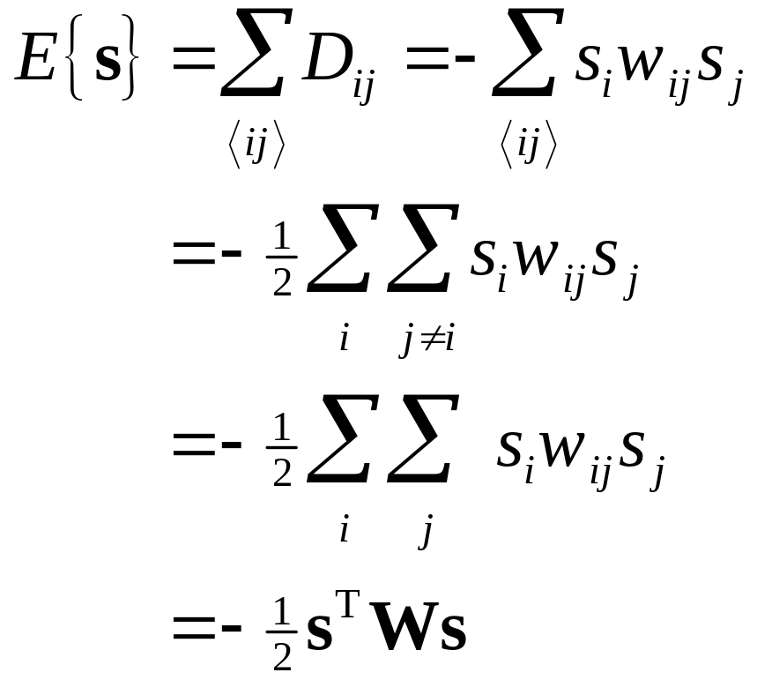
Total Energy of System
The “energy” of the system is the total “tension” (disharmony) in it:
Notes:
Part 3A: Hopfield Network

Slide 23
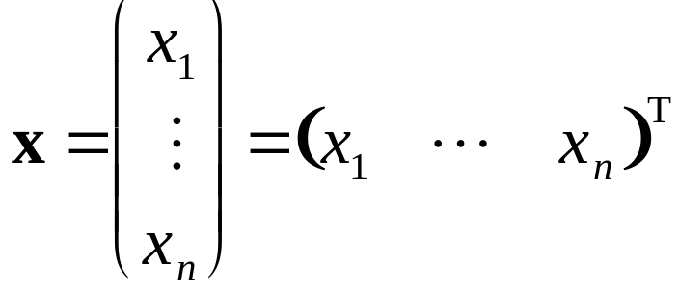
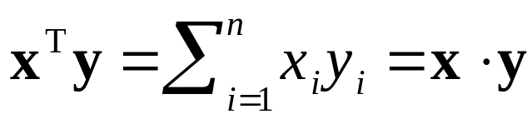
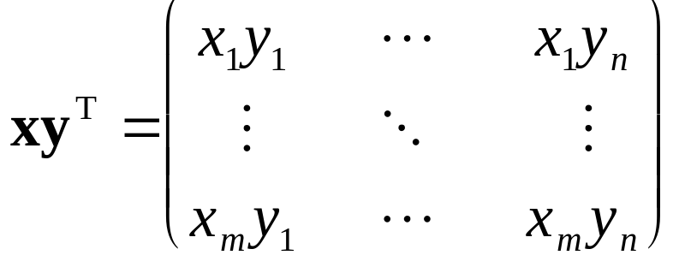
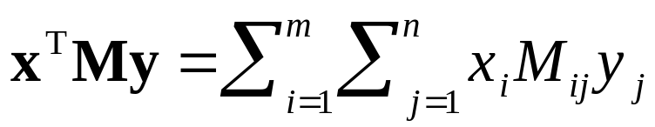
Review of Some Vector Notation
(column vectors)
(inner product)
(outer product)
(quadratic form)
Notes:
Part 3A: Hopfield Network

Slide 24
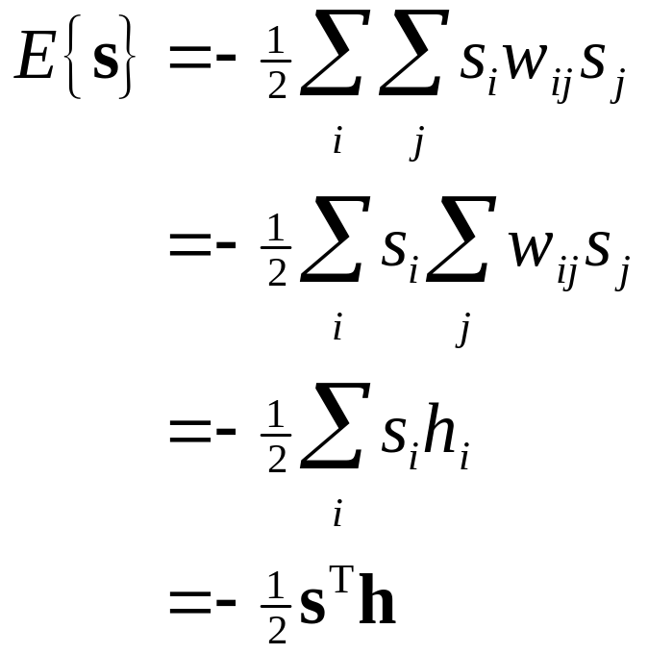
Another View of Energy
The energy measures the number of neurons whose states are in disharmony with their local fields (i.e. of opposite sign):
Notes:
Part 3A: Hopfield Network

Slide 25
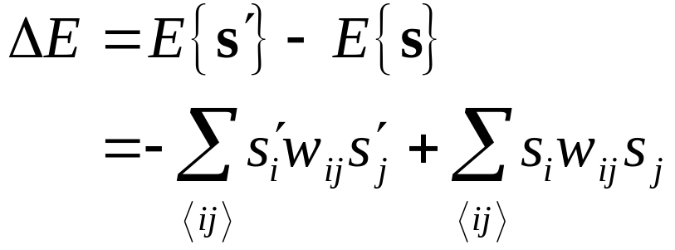
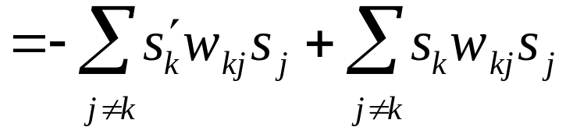
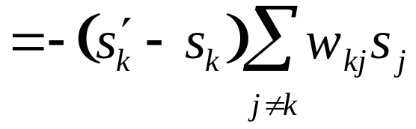


Do State Changes Decrease Energy?
Suppose that neuron k changes state
Change of energy:
Notes:
Part 3A: Hopfield Network
The last, strict, inequality holds because we are assuming s_{k} changed, and this happens only if h is nonzero

Slide 26
Energy Does Not Increase
In each step in which a neuron is considered for update:
E{s(t + 1)} – E{s(t)} ≤ 0
Energy cannot increase
Energy decreases if any neuron changes
Must it stop?
Notes:
Part 3A: Hopfield Network

Slide 27
Proof of Convergence in Finite Time
There is a minimum possible energy:
  The number of possible states s ∈ {–1, +1}^{n} is finite
  Hence E_{min} = min {E(s) | s ∈ {±1}^{n}} exists
Must show it is reached in a finite number of steps
Notes:
Part 3A: Hopfield Network

Slide 28
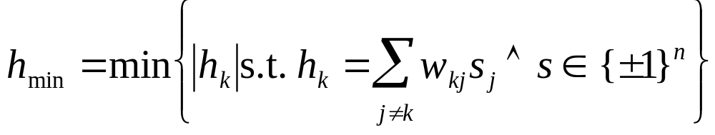
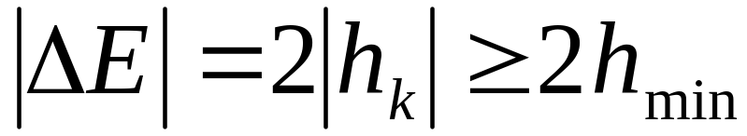
Steps are of a Certain Minimum Size
Notes:
Part 3A: Hopfield Network

Slide 29
Conclusion
If we do asynchronous updating, the Hopfield net must reach a stable, minimum energy state in a finite number of updates
This does not imply that it is a global minimum
Notes:
Part 3A: Hopfield Network

Slide 30
Lyapunov Functions
A way of showing the convergence of discrete- or continuous-time dynamical systems
For discrete-time system:
  need a Lyapunov function E (“energy” of the state)
  E is bounded below (E{s} > E_{min})
  ΔE < (ΔE)_{max} ≤ 0 (energy decreases a certain minimum amount each step)
  then the system will converge in finite time
Problem: finding a suitable Lyapunov function
Notes:
Part 3A: Hopfield Network

Slide 31
Example Limit Cycle with Synchronous Updating
w > 0
w > 0
Notes:
Part 3A: Hopfield Network

Slide 32
The Hopfield Energy Function is Even
A function f is odd if f (–x) = – f (x),
for all x
A function f is even if f (–x) = f (x),
for all x
Observe:
Notes:
Part 3A: Hopfield Network

Slide 33
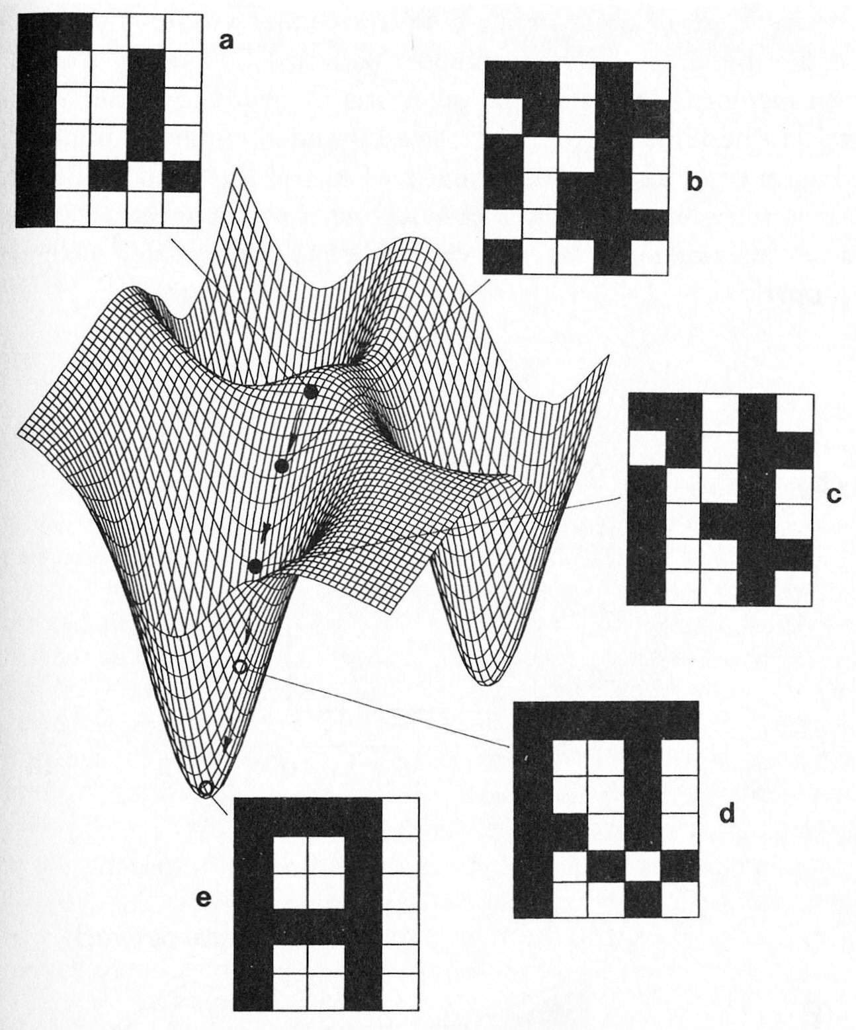
Conceptual Picture of Descent on Energy Surface
(fig. from Solé & Goodwin)
Notes:
Part 3A: Hopfield Network
Note that this assumes a 2D continuous state space
(SG fig. 5.5)

Slide 34
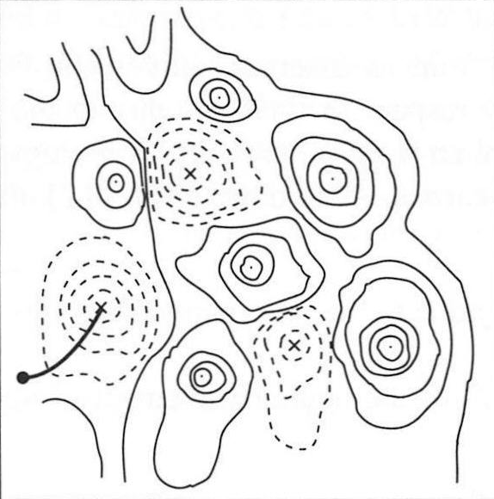
Energy Surface
(fig. from Haykin Neur. Netw.)
Notes:
Part 3A: Hopfield Network
Solid lines are hills, dotted are valleys
Again a 2D continuous state space
On the right is one possible trajectory
From an initial starting point, the trajectory is fixed for a deterministic system
We can plot all possible trajectories (which must be nonincreasing in energy)
These are flow lines
Next consider just the flow lines
(Haykin fig. 8.1a)

Slide 35
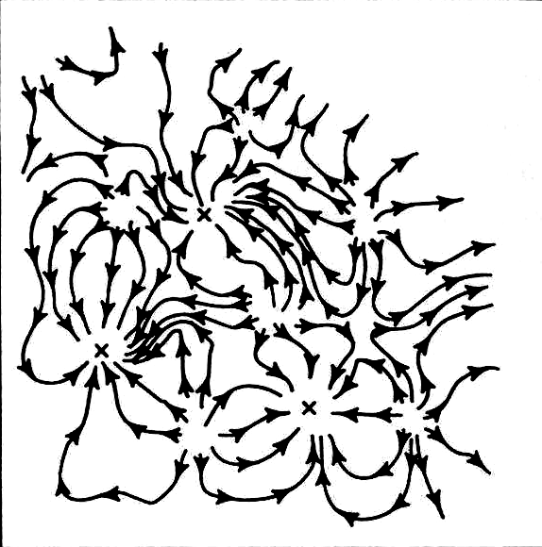
Energy Surface +
Flow Lines
(fig. from Haykin Neur. Netw.)
Notes:
Part 3A: Hopfield Network
Solid lines are hills, dotted are valleys
Again a 2D continuous state space
On the right is one possible trajectory
From an initial starting point, the trajectory is fixed for a deterministic system
We can plot all possible trajectories (which must be nonincreasing in energy)
These are flow lines
Next consider just the flow lines
(Haykin fig. 8.1a)

Slide 36
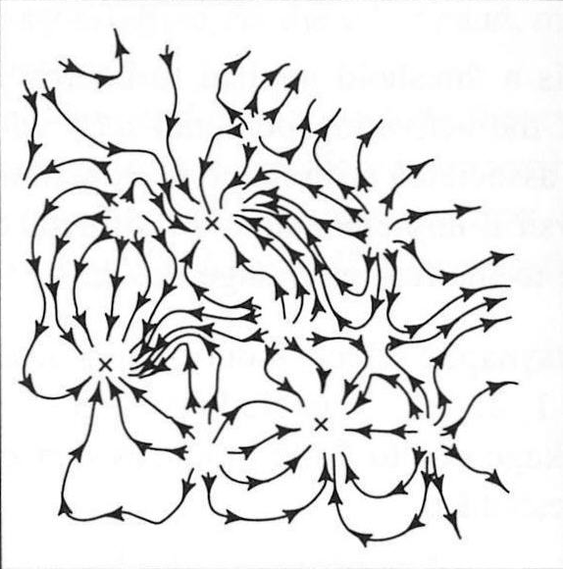
Flow Lines
Basins of
Attraction
(fig. from Haykin Neur. Netw.)
Notes:
Part 3A: Hopfield Network
Solid lines are hills, dotted are valleys
The boundaries between basins are saddle points where we can get stuck (only move along them)
Slightest perturbation will put us in a basin
This occurs in continuous state spaces
But in a discrete state space, every possible state may occur within a basin (as in Hopfield)
Note repeller (yellow) and unstable attractor (blue) on the boundary in lower left quadrant
(Haykin fig. 8.1a)

Slide 37
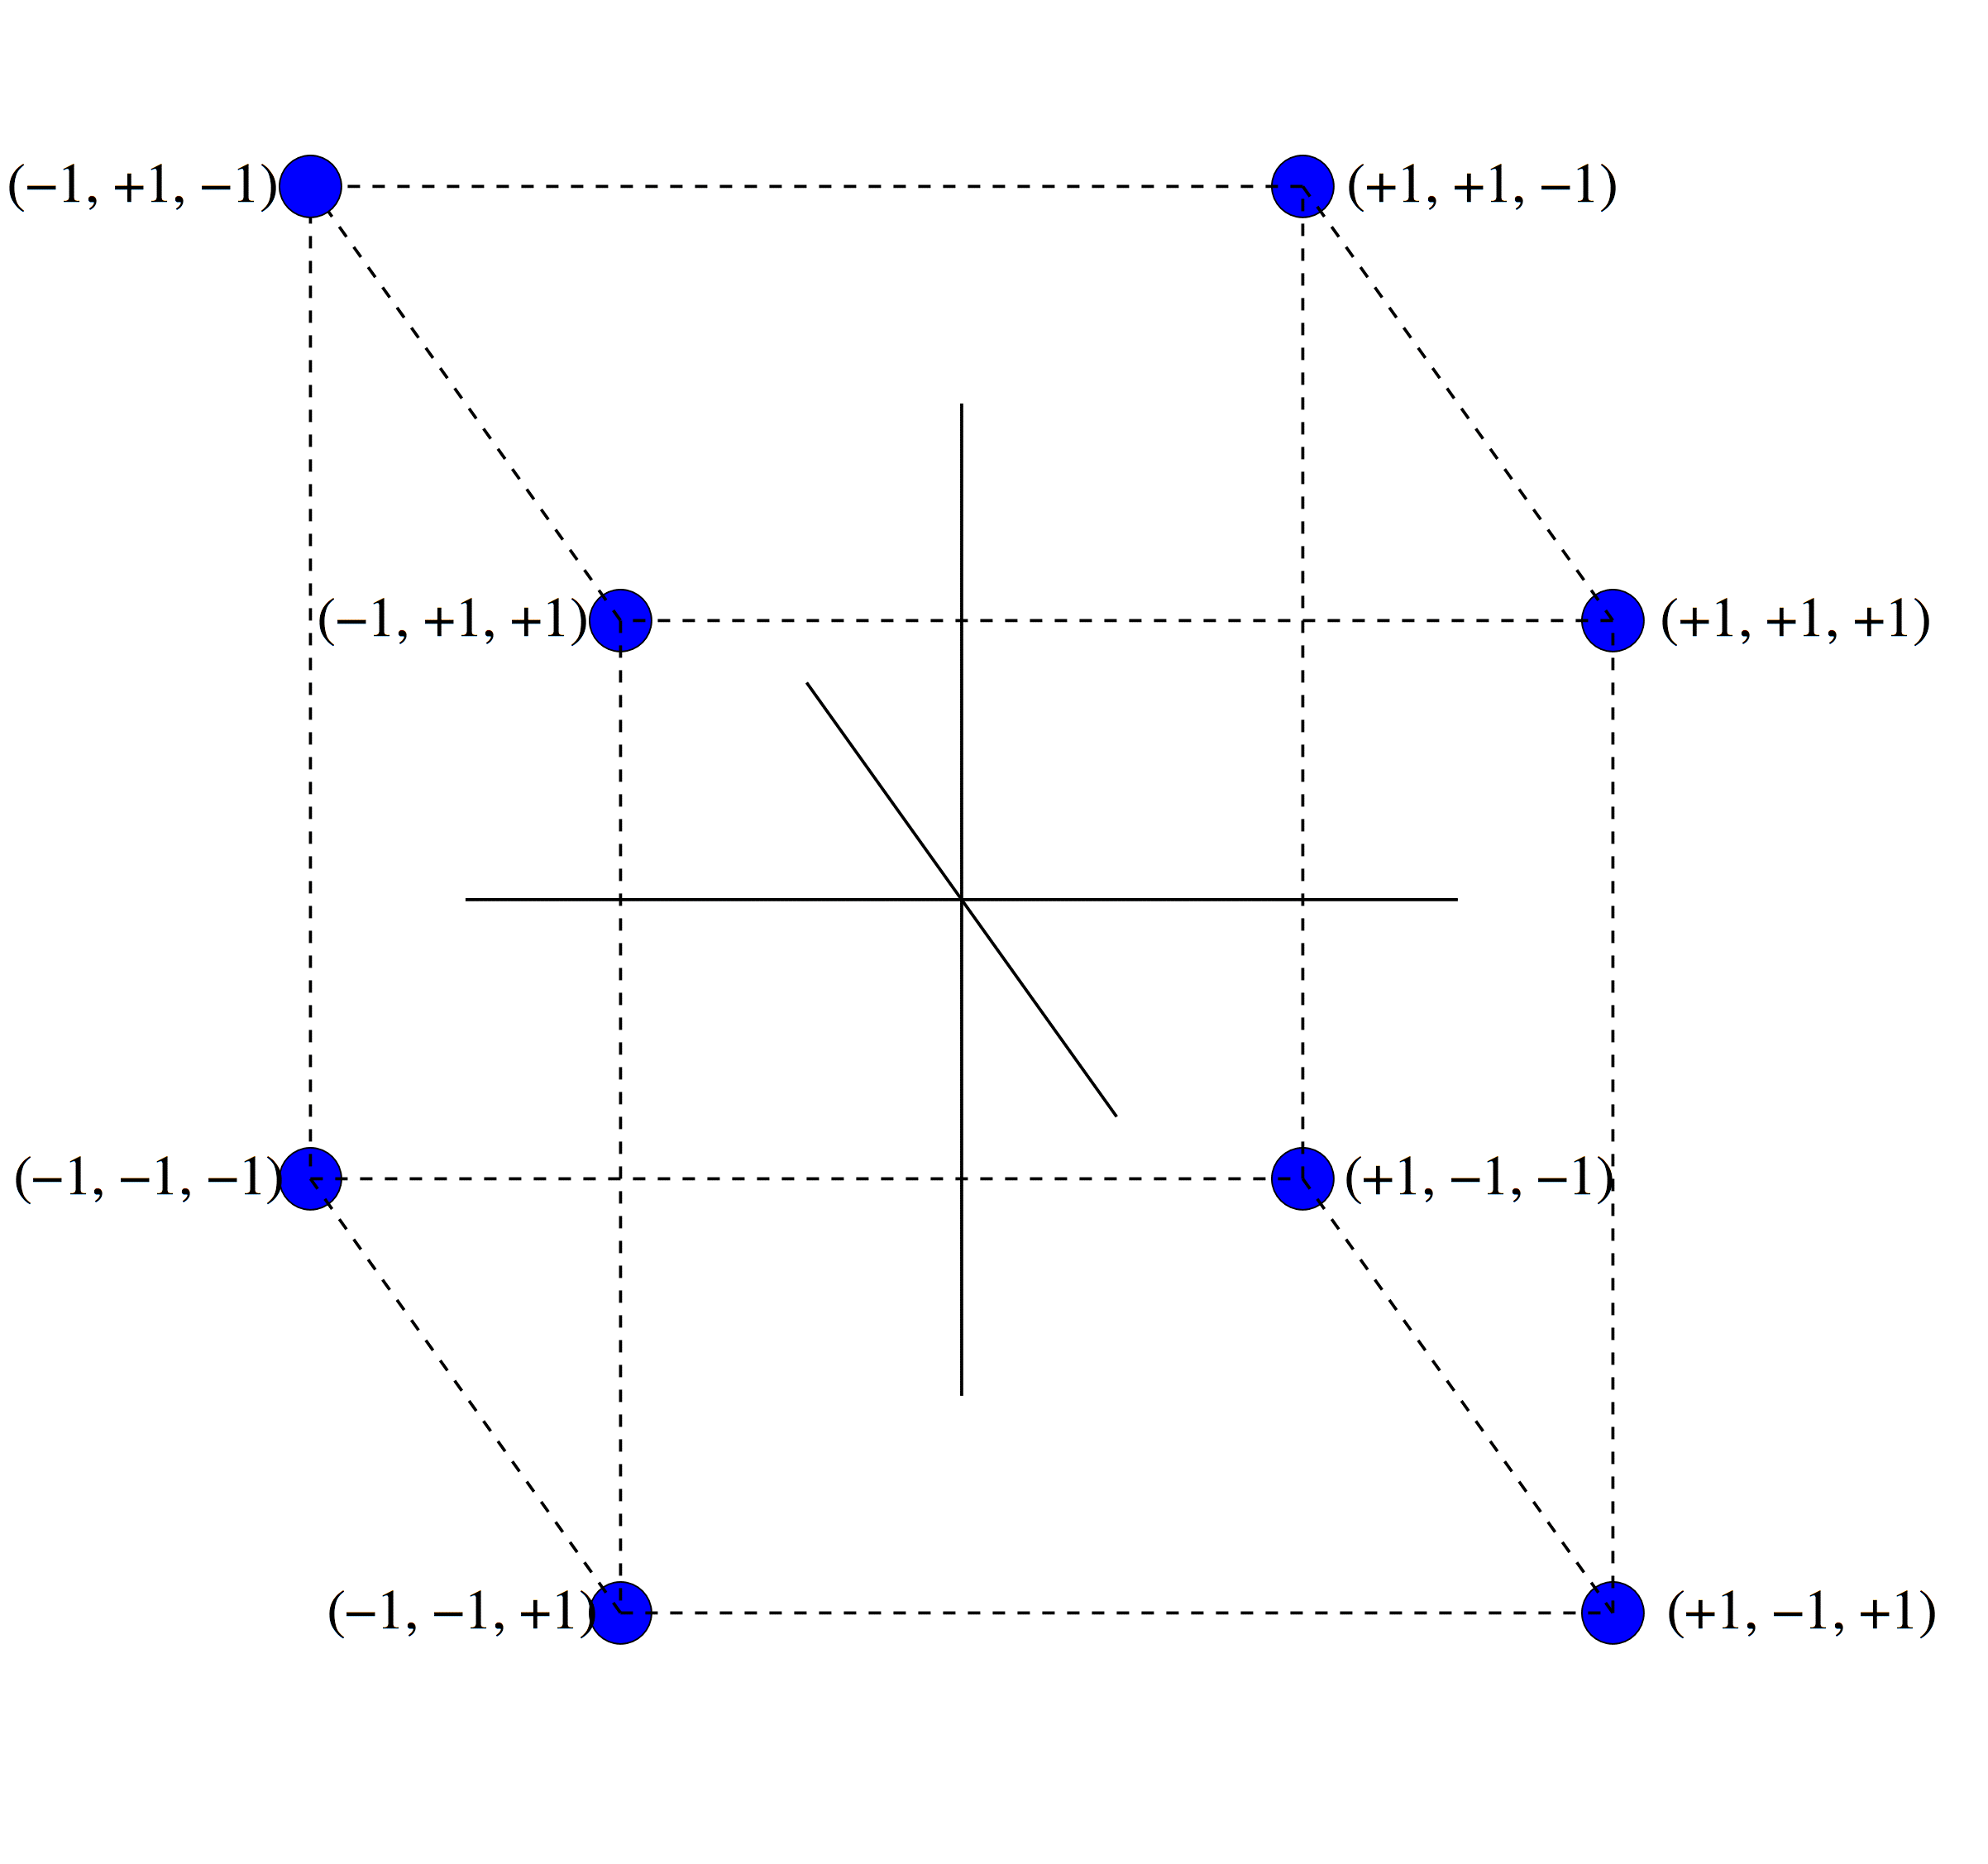
Bipolar State Space
Notes:
Part 3A: Hopfield Network
This is a 3D space; typically we deal with much higher dimensions
State moves discretely from corner to corner, always decreasing energy

Slide 38
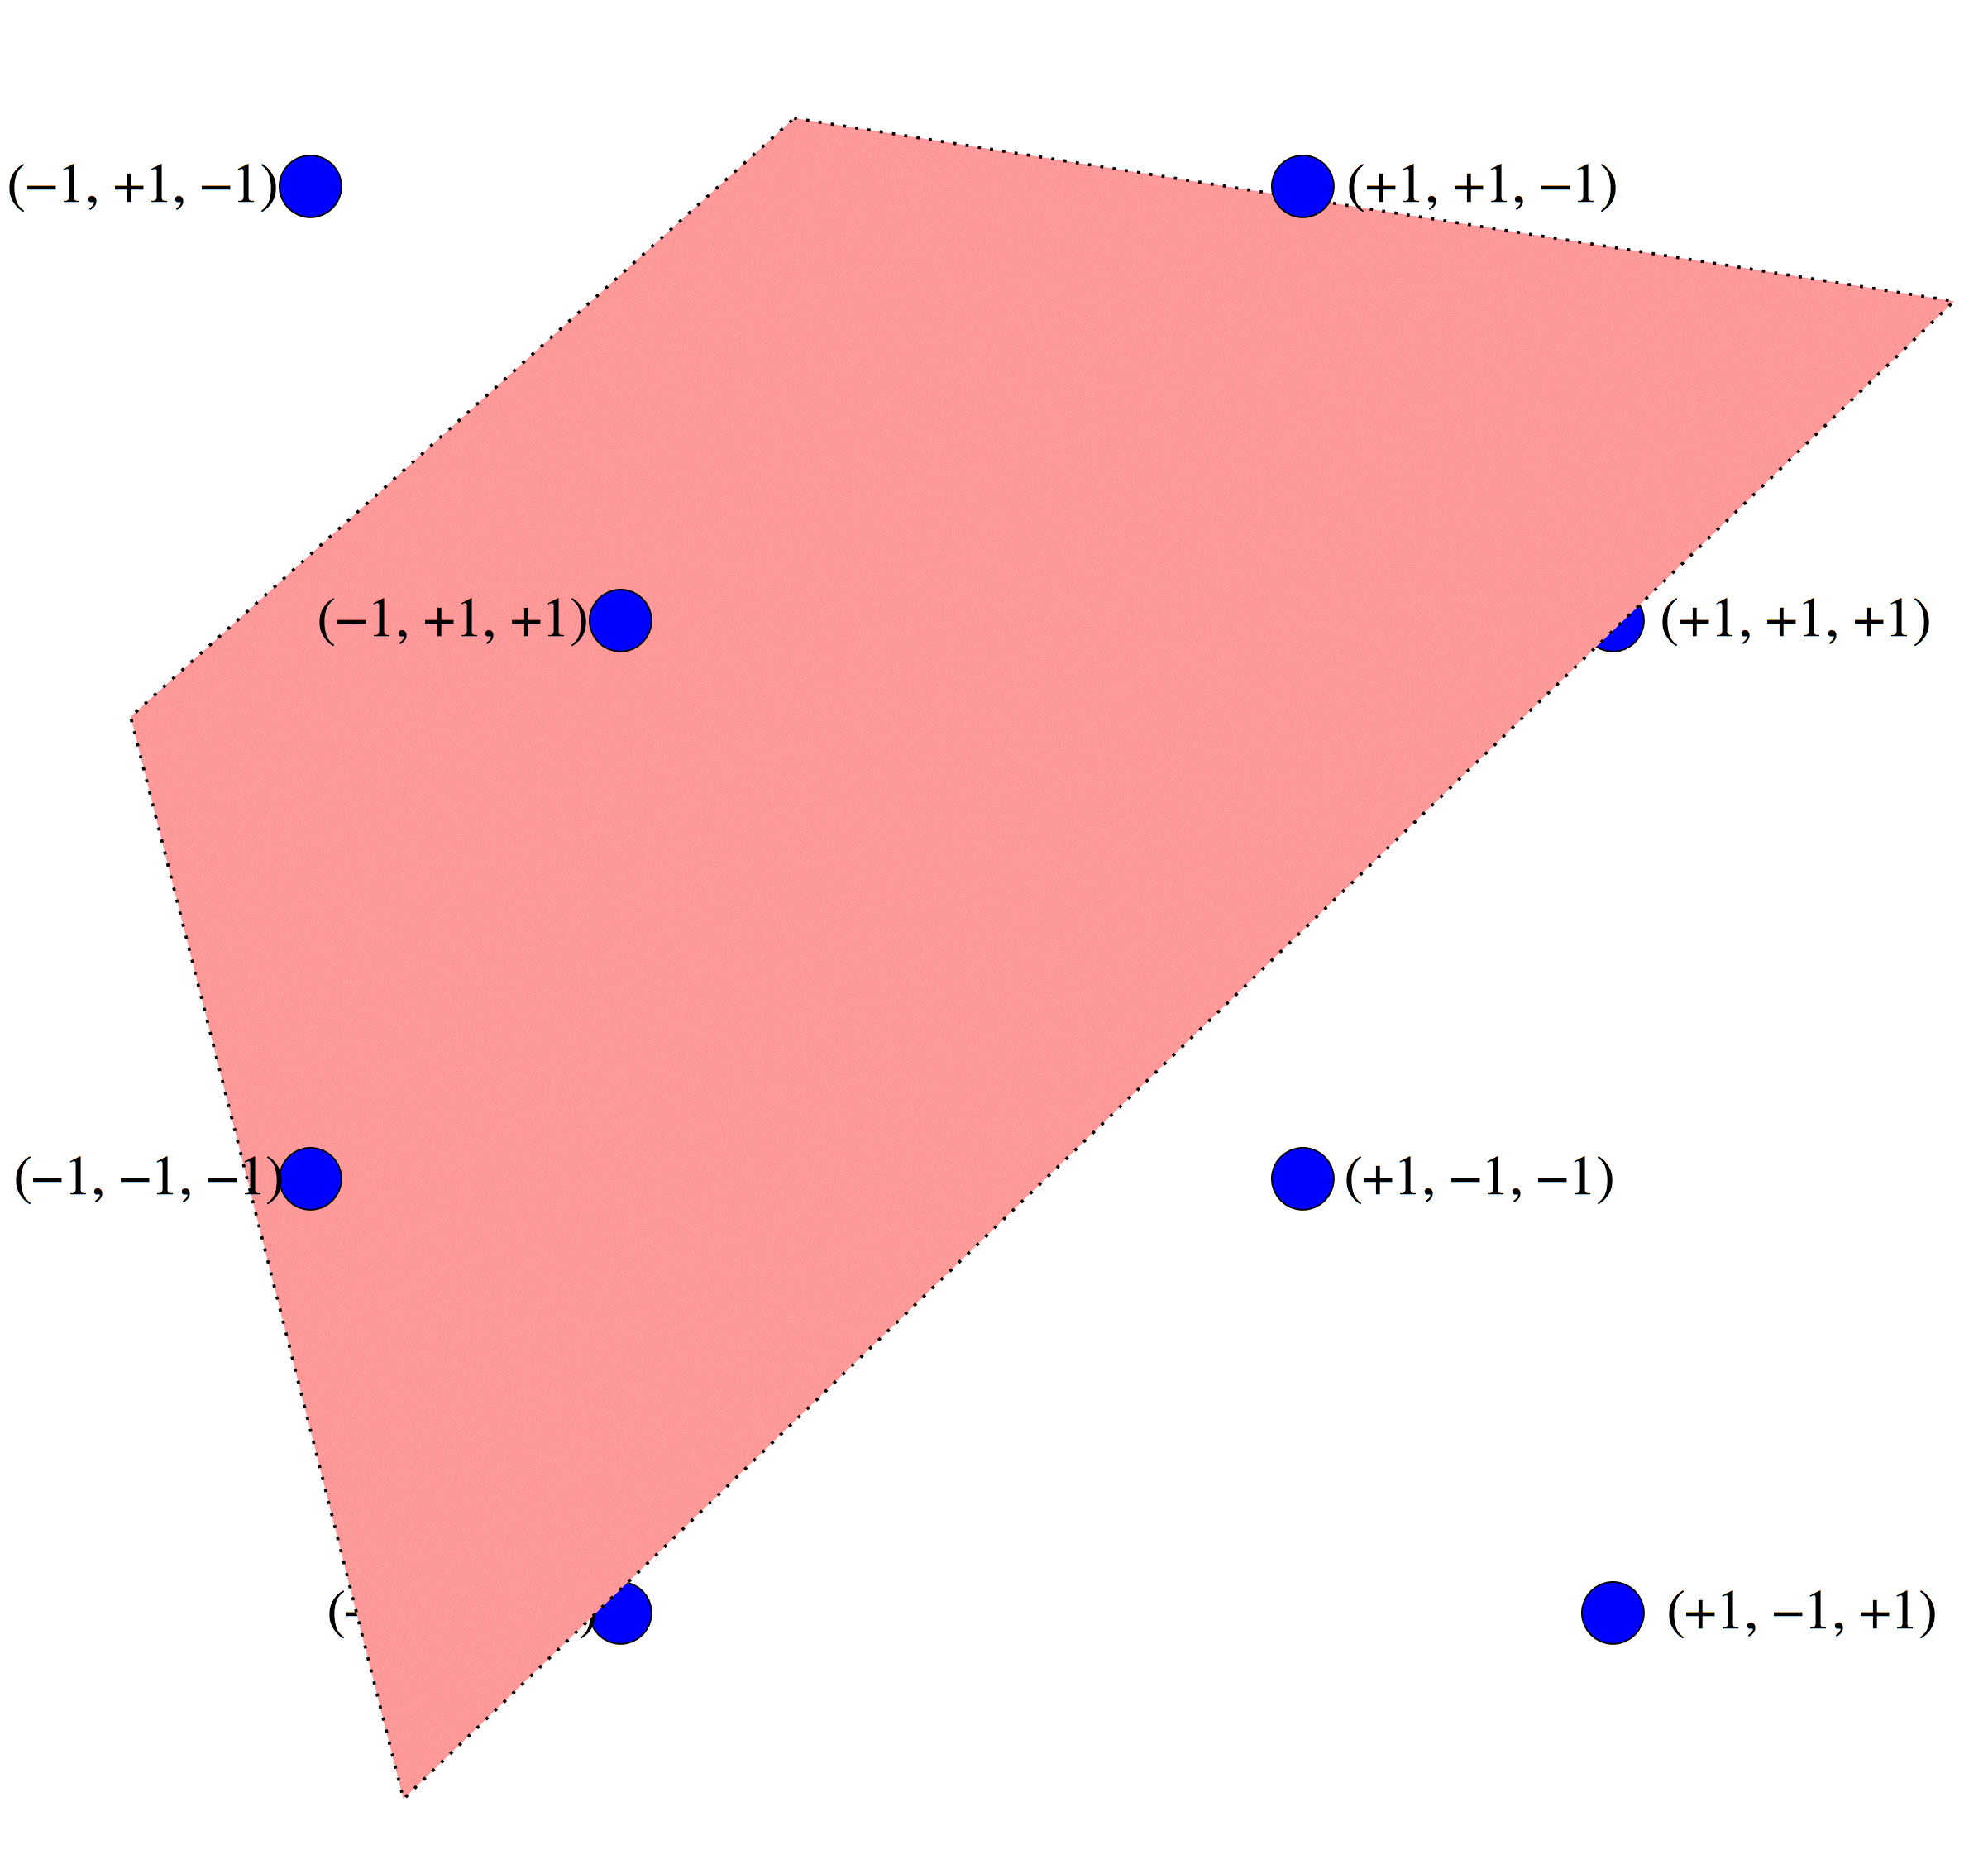
Basins in Bipolar State Space
energy decreasing paths
Notes:
Part 3A: Hopfield Network
Note how the paths are completely symmetric under sign change (required by even energy function)

Slide 39
Demonstration of Hopfield Net Dynamics II
Run initialized Hopfield.nlogo
Notes:
Part 3A: Hopfield Network
Import Hopfield world A.csv. Demo updating on cell at a time.

Slide 40
Storing Memories as Attractors
(fig. from Solé & Goodwin)
Notes:
Part 3A: Hopfield Network
Note that this assumes a 2D continuous state space
Introduce term retrieval state
(SG fig. 5.5)

Slide 41
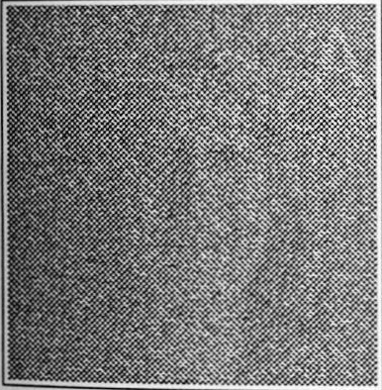
Example of Pattern Restoration
(fig. from Arbib 1995)
Notes:
Part 3A: Hopfield Network
(HBTNN p. 265)

Slide 42
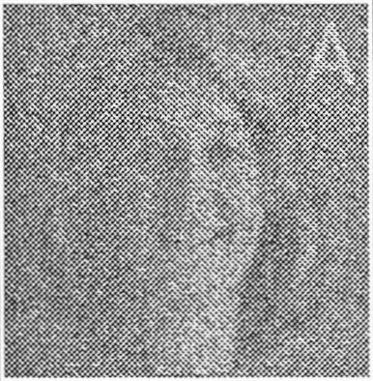
Example of Pattern Restoration
(fig. from Arbib 1995)
Notes:
Part 3A: Hopfield Network
(HBTNN p. 265)

Slide 43

Example of Pattern Restoration
(fig. from Arbib 1995)
Notes:
Part 3A: Hopfield Network
(HBTNN p. 265)

Slide 44

Example of Pattern Restoration
(fig. from Arbib 1995)
Notes:
Part 3A: Hopfield Network
(HBTNN p. 265)

Slide 45

Example of Pattern Restoration
(fig. from Arbib 1995)
Notes:
Part 3A: Hopfield Network
(HBTNN p. 265)

Slide 46
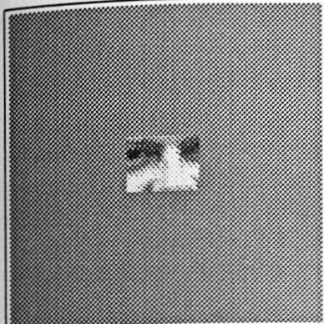
Example of Pattern Completion
(fig. from Arbib 1995)
Notes:
Part 3A: Hopfield Network
(HBTNN p. 265)

Slide 47
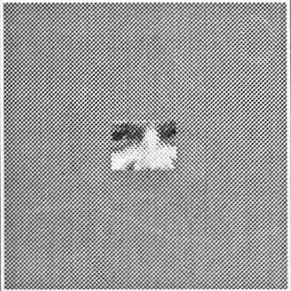
Example of Pattern Completion
(fig. from Arbib 1995)
Notes:
Part 3A: Hopfield Network
(HBTNN p. 265)

Slide 48
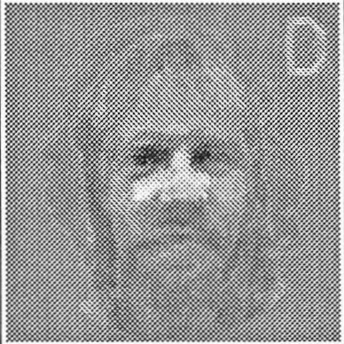
Example of Pattern Completion
(fig. from Arbib 1995)
Notes:
Part 3A: Hopfield Network
Note the ghost image of the woman in addition to the man
(HBTNN p. 265)

Slide 49
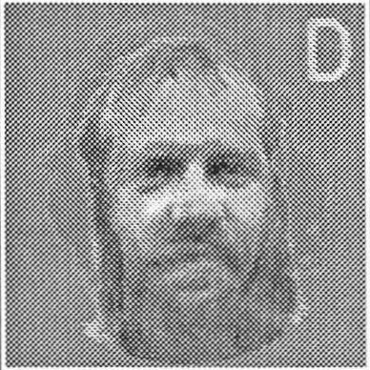
Example of Pattern Completion
(fig. from Arbib 1995)
Notes:
Part 3A: Hopfield Network
(HBTNN p. 265)

Slide 50
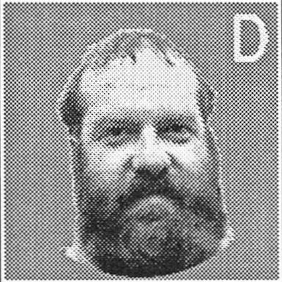
Example of Pattern Completion
(fig. from Arbib 1995)
Notes:
Part 3A: Hopfield Network
(HBTNN p. 265)

Slide 51
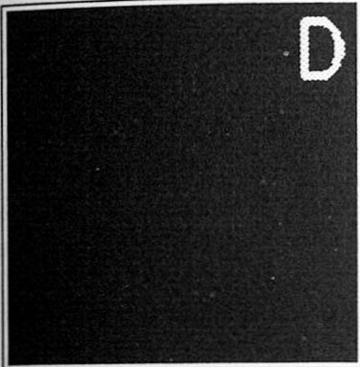
Example of Association
(fig. from Arbib 1995)
Notes:
Part 3A: Hopfield Network
(HBTNN p. 265)

Slide 52
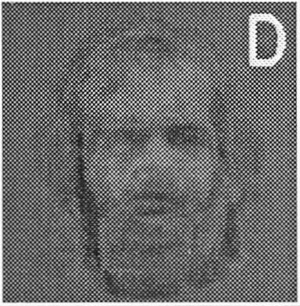
Example of Association
(fig. from Arbib 1995)
Notes:
Part 3A: Hopfield Network
(HBTNN p. 265)

Slide 53
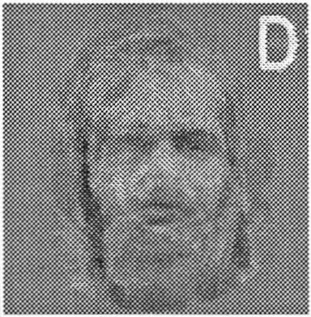
Example of Association
(fig. from Arbib 1995)
Notes:
Part 3A: Hopfield Network
(HBTNN p. 265)

Slide 54
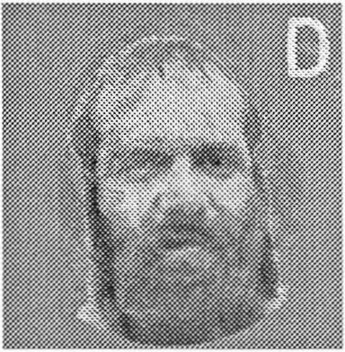
Example of Association
(fig. from Arbib 1995)
Notes:
Part 3A: Hopfield Network
(HBTNN p. 265)

Slide 55
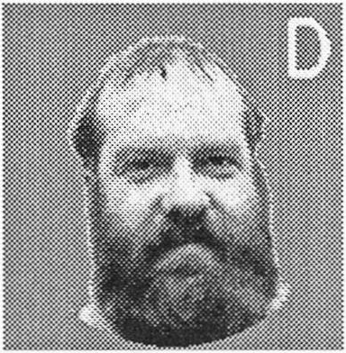
Example of Association
(fig. from Arbib 1995)
Notes:
Part 3A: Hopfield Network
(HBTNN p. 265)

Slide 56
Applications of
Hopfield Memory
Pattern restoration
Pattern completion
Pattern generalization
Pattern association
Notes:
Part 3A: Hopfield Network

Slide 57
Hopfield Net for Optimization and for Associative Memory
For optimization:
  we know the weights (couplings)
  we want to know the minima (solutions)
For associative memory:
  we know the minima (retrieval states)
  we want to know the weights
Notes:
Part 3A: Hopfield Network

Slide 58
Hebb’s Rule
“When an axon of cell A is near enough to excite a cell B and repeatedly or persistently takes part in firing it, some growth or metabolic change takes place in one or both cells such that A’s efficiency, as one of the cells firing B, is increased.”
—Donald Hebb (The Organization of Behavior, 1949, p. 62)
Notes:
Part 3A: Hopfield Network

Slide 59
Example of Hebbian Learning:
Pattern Imprinted
Notes:
Part 3A: Hopfield Network
Call this a “cell assembly”
The connections come to reflect the coordinated activity of the cells
(Actually, this is not such a good example, since there are an even number of inputs to each cell, and so they are all balanced plus and minus; might work better with K₆)

Slide 60
Example of Hebbian Learning:
Partial Pattern Reconstruction
Notes:
Part 3A: Hopfield Network
The weights allow restoration of the complete pattern of coordinated activity
Note that we may leave the external inputs clamped or not, depending on
how much we trust them
conversely, how willing we are to have them change during retrieval

Slide 61
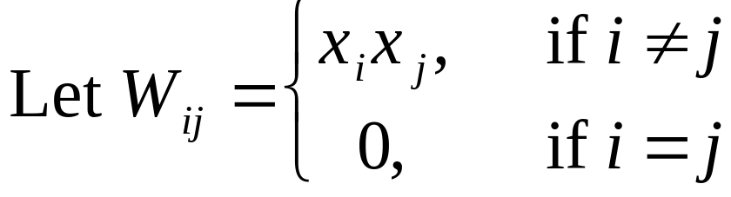
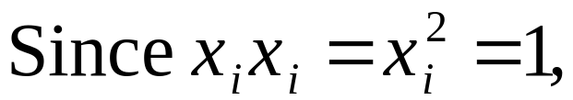


Mathematical Model of Hebbian Learning for One Pattern
For simplicity, we will include self-coupling:
Notes:
Part 3A: Hopfield Network
The inclusion of self-coupling does not make an appreciable difference to stability of stored patterns in large n limit (Hertz & al 22)

Slide 62
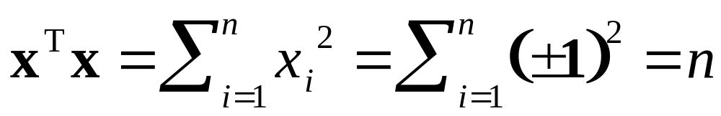
A Single Imprinted Pattern is a Stable State
Suppose W = xx^{T}
Then h = Wx = xx^{T}x = nx
since
Hence, if initial state is s = x, then new state is s′ = sgn (n x) = x
May be other stable states (e.g., –x)
Notes:
Part 3A: Hopfield Network

Slide 63
Questions
How big is the basin of attraction of the imprinted pattern?
How many patterns can be imprinted?
Are there unneeded spurious stable states?
These issues will be addressed in the context of multiple imprinted patterns
Notes:
Part 3A: Hopfield Network

Slide 64
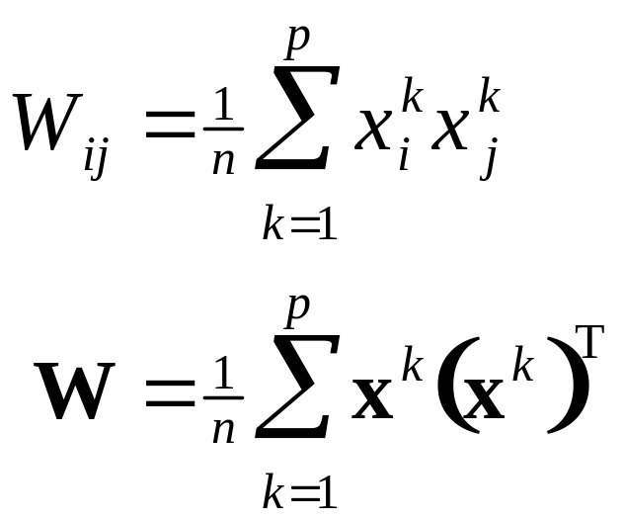
Imprinting Multiple Patterns
Let x¹, x², …, x^{p} be patterns to be imprinted
Define the sum-of-outer-products matrix:
Notes:
Part 3A: Hopfield Network

Slide 65
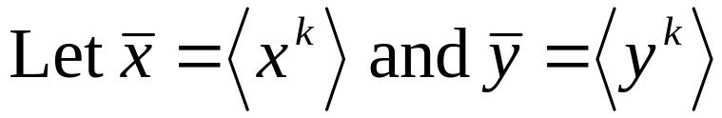
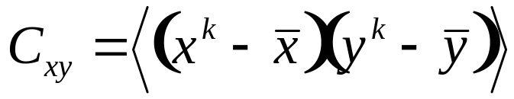
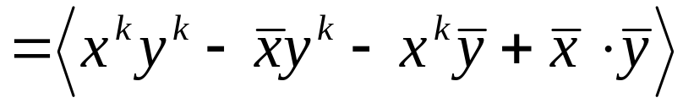
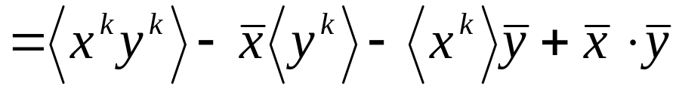
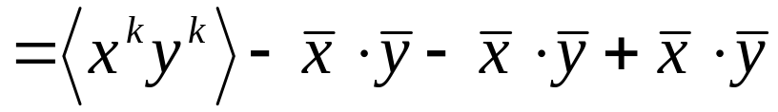
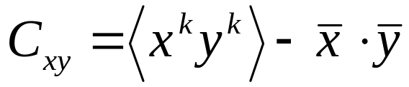
Definition of Covariance
Consider samples (x¹, y¹), (x², y²), …, (x^{N}, y^{N})
Notes:
Part 3A: Hopfield Network

Slide 66
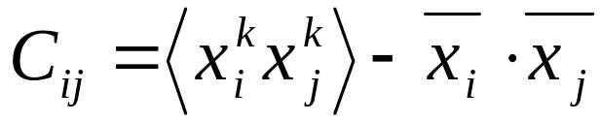
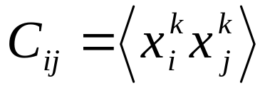
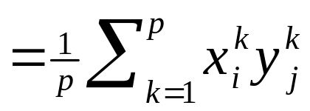
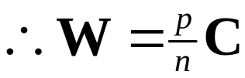
Weights & the Covariance Matrix
Sample pattern vectors: x¹, x², …, x^{p}
Covariance of i^{th} and j^{th} components:
Notes:
Part 3A: Hopfield Network

Slide 67
Characteristics of Hopfield Memory
Distributed (“holographic”)
  every pattern is stored in every location (weight)
Robust
  correct retrieval in spite of noise or error in patterns
  correct operation in spite of considerable weight damage or noise
Notes:
Part 3A: Hopfield Network

Slide 68
Demonstration of Hopfield Net
Run Malasri Hopfield Demo
Notes:
Part 3A: Hopfield Network
Use the preloaded patterns 1, 2, 3, 4.

Slide 69
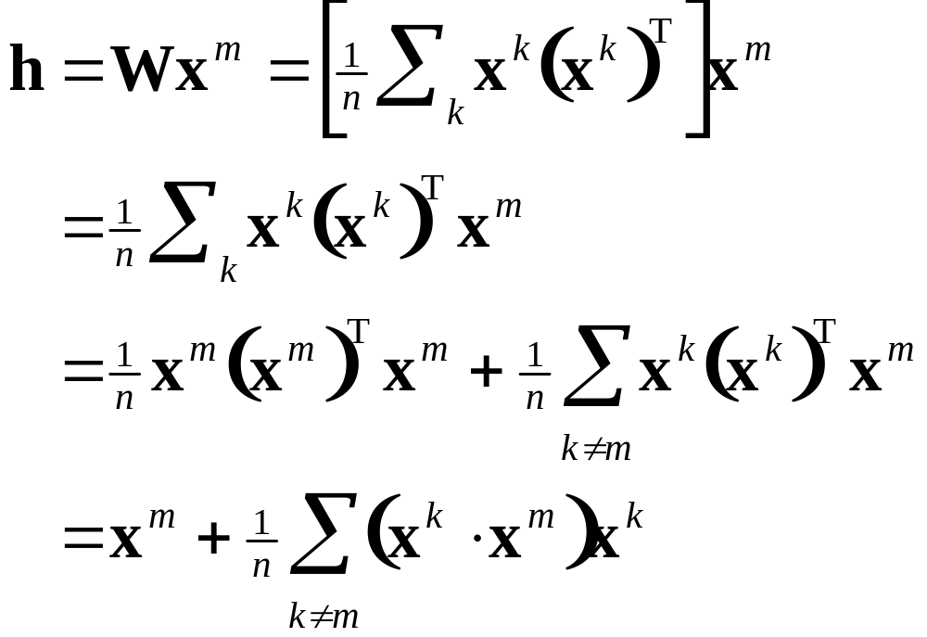
Stability of Imprinted Memories
Suppose the state is one of the imprinted patterns x^{m}
Then:
Notes:
Part 3A: Hopfield Network

Slide 70
Interpretation of Inner Products
x^{k} ⋅ x^{m} = n if they are identical
  highly correlated
x^{k} ⋅ x^{m} = –n if they are complementary
  highly correlated (reversed)
x^{k} ⋅ x^{m} = 0 if they are orthogonal
  largely uncorrelated
x^{k} ⋅ x^{m} measures the crosstalk between patterns k and m
Notes:
Part 3A: Hopfield Network
Talk about in terms of whether the corresponding bits are positively or negatively correlated or neither
Point out that the inner product is a similarity measure

Slide 71
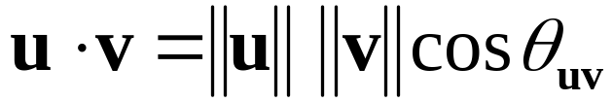



Cosines and Inner products
u
v
Notes:
Part 3A: Hopfield Network
The cosine is also a similarity measure.
Note the n cancels the 1/n in front of the summation.

Slide 72


Conditions for Stability
Notes:
Part 3A: Hopfield Network
The condition is required to ensure that we are dividing by a positive number
So the stored pattern will be stable provided that the crosstalk terms are not so large as to overwhelm it

Slide 73


Sufficient Conditions for Instability (Case 1)
Notes:
Part 3A: Hopfield Network
Under these conditions, if we start in the desired state, it will not stay there

Slide 74


Sufficient Conditions for Instability (Case 2)
Notes:
Part 3A: Hopfield Network

Slide 75

Sufficient Conditions for Stability
The crosstalk with the sought pattern must be sufficiently small
Notes:
Part 3A: Hopfield Network

Slide 76
Capacity of Hopfield Memory
Depends on the patterns imprinted
If orthogonal, p_{max} = n
  but every state is stable ⇒ trivial basins
So p_{max} < n
Let load parameter α = p / n
equations
Notes:
Part 3A: Hopfield Network

Slide 77


Single Bit Stability Analysis
For simplicity, suppose x^{k} are random
Then x^{k} ⋅ x^{m} are sums of n random ±1
  binomial distribution ≈ Gaussian
  in range –n, …, +n
  with mean μ = 0
  and variance σ² = n
Probability sum > t:
[See “Review of Gaussian (Normal) Distributions” on course website]
Notes:
Part 3A: Hopfield Network
No time to review prob & statistics
These are n independent, equal probability Bernoulli trials with zero mean
A binomial distribution, which is approximated by Gaussian for large n

Slide 78




Approximation of Probability
Notes:
Part 3A: Hopfield Network

Slide 79


Probability of Bit Instability
(fig. from Hertz & al. Intr. Theory Neur. Comp.)
Notes:
Part 3A: Hopfield Network
(Hertz & al. fig. 2.5)

Slide 80
Tabulated Probability of
Single-Bit Instability
P_{error} | α
0.1% | 0.105
0.36% | 0.138
1% | 0.185
5% | 0.37
10% | 0.61
(table from Hertz & al. Intr. Theory Neur. Comp.)
Notes:
Part 3A: Hopfield Network
This is the probability that a single bit will flip, but we don’t know that the changes will stop there
It could trigger a cascade of changes and lead eventually to a very different state
For example, at α = 0.138, only 0.36% are initially unstable, but 1.6% will flip before attractor reached
Will see that for α > 0.138, will get an avalanch of changes
(Hertz & al. 19)

Slide 81
Spurious Attractors
Mixture states:
  sums or differences of odd numbers of retrieval states
  number increases combinatorially with p
  shallower, smaller basins
  basins of mixtures swamp basins of retrieval states ⇒ overload
  useful as combinatorial generalizations?
  self-coupling generates spurious attractors
Spin-glass states:
  not correlated with any finite number of imprinted patterns
  occur beyond overload because weights effectively random
Notes:
Part 3A: Hopfield Network
Odd numbers:
The reversal state is the simplest example of a mixture state (a mixture of 1)
Even numbers do not usually generate mixture states,
because they may have 0 components, which are not possible states
Mixture states are equidistant (Hamming distance) from retrieval states
Number increases combinatorially (more than exponentially) because formed of all possible combinations
There are 2³ = 8 possible 3-mixture states for each triple of retrieval states
Swamping: recall overload occurs when basins collapse
Useful?
If retrieval states are “good” (minima), mixture states are combinations of good states,
which are also, to some degree, good
In appropriate context, these might be useful generalizations of stored patterns
(see also Anderson 412)
Self-coupling:
e.g. if it is sufficiently strong, guarantees a neurons state is stable, no matter what its local field
creates additional attractors in neighborhood of retrieval states
(e.g. in above example, at Hamming distance of 1)
reduces basins of retrieval states
Spin-glass states:
for large p
With effectively random weights, the noise is larger than the signal
Energy is effectively a sum over random variables
You get a hierarchically-structured set of minima with large barriers between
the lowest minima are not retrieval states
May be “melted” by sufficiently high T (HKP 40)
(HKP 24; BY 320, 322; Haykin 303)

Slide 82





Basins of Mixture States
Notes:
Part 3A: Hopfield Network

Slide 83

Fraction of Unstable Imprints
(n = 100)
(fig from Bar-Yam)
Notes:
Part 3A: Hopfield Network
Simulation
n =100
(Bar-Yam fig. 2.2.5)

Slide 84

Number of Stable Imprints
(n = 100)
(fig from Bar-Yam)
Notes:
Part 3A: Hopfield Network
Simulation
n =100
Above 15 imprints, the number gradually decreases to zero, but their basins are very small
(Bar-Yam fig. 2.2.6)

Slide 85

Number of Imprints with Basins of Indicated Size (n = 100)
(fig from Bar-Yam)
Notes:
Part 3A: Hopfield Network
Simulation
n =100
B is size of basin measured by Hamming distance
histograms normalized to p
size of basins decreases with number of patterns
Above 10 imprints, the number of unstable patterns (shown here with basin size 0) begins to increase
(Bar-Yam fig. 2.2.7b)

Slide 86
Summary of Capacity Results
Absolute limit: p_{max} < α_{c}n = 0.138 n
If a small number of errors in each pattern permitted: p_{max} ∝ n
If all or most patterns must be recalled perfectly: p_{max} ∝ n / log n
Recall: all this analysis is based on random patterns
Unrealistic, but sometimes can be arranged
III B
Notes:
Part 3A: Hopfield Network
(Hertz & al. 20)

